Slide 1
CMSI 533 : End-to-End Data Science Project
Dataset – IPL 2024 : Player Lifetime Dataset
https://www.kaggle.com/datasets/aryanverma99/ipl-2024-player-lifetime-dataset
- Avi Patel

Slide 2
Data Description
What is your dataset about?
- My Dataset is IPL 2024 : Player Lifetime Dataset and it provides comprehensive data on
the career trajectories of players participating in IPL.
How many rows and how many columns are there?
- The dataset comprises 1173 rows and 25 columns.
What variable do you want to predict and why?
- Here, the variable I want to predict is “Batting_Strike_Rate“. Because it directly measures a
player's effectiveness in scoring runs efficiently, making it a crucial metric for assessing
batting performance and strategy in cricket analysis.

Slide 3
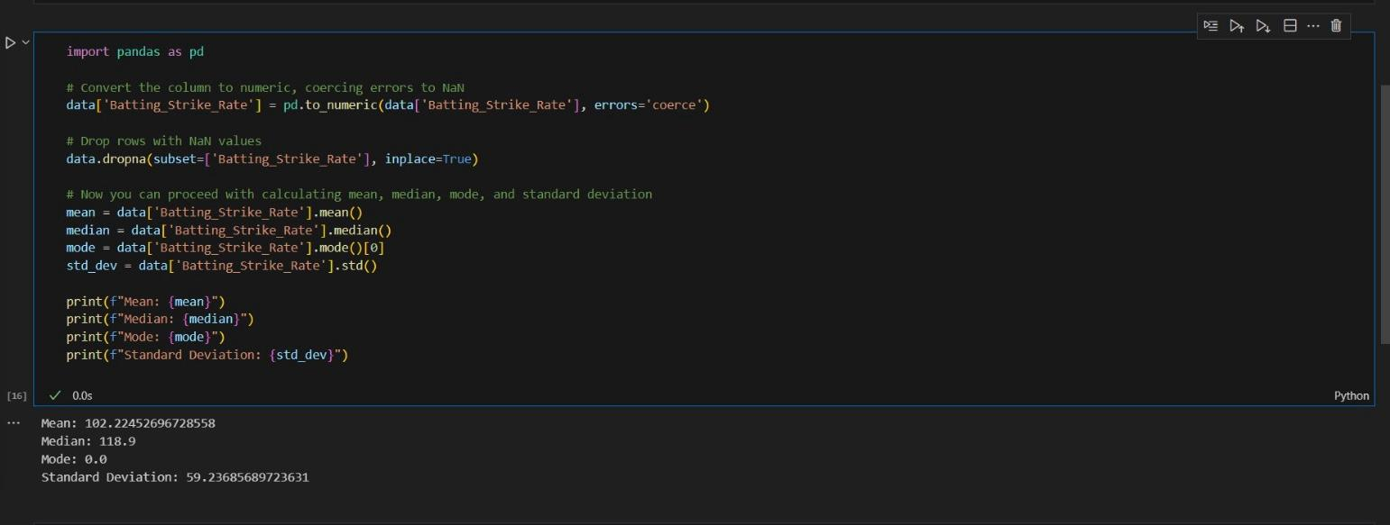
Calculation of mean, median, mode & SD

Slide 4
Descriptive Statistics
Mean -> The average value of batting strike rates in the dataset is approximately 102.22, calculated by summing all rates and dividing by the total count of rates.
Median -> The middle value of batting strike rates in the dataset is 118.9, indicating that half of the rates are above and half are below this value when arranged in ascending order.
Mode -> The most frequently occurring batting strike rate in the dataset is 0.0, suggesting that this rate appears more often than any other rate, possibly representing instances of batsmen not scoring runs.
Standard Deviation -> The measure of dispersion or variability in batting strike rates from the mean is approximately 59.24. It indicates how much the rates deviate from the average, with higher values suggesting greater variability among the rates.

Slide 5
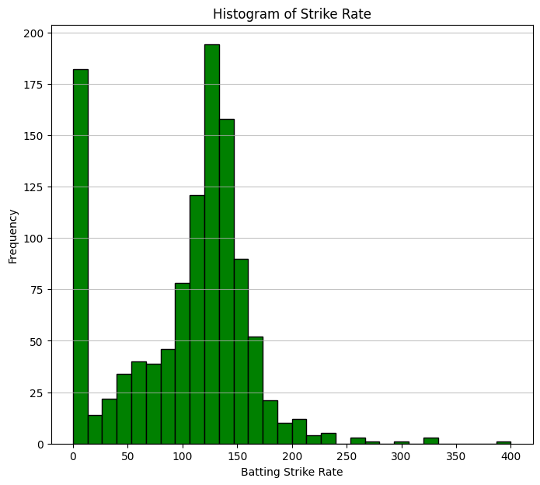
Histogram of Batting strike rate Column
-

Slide 6
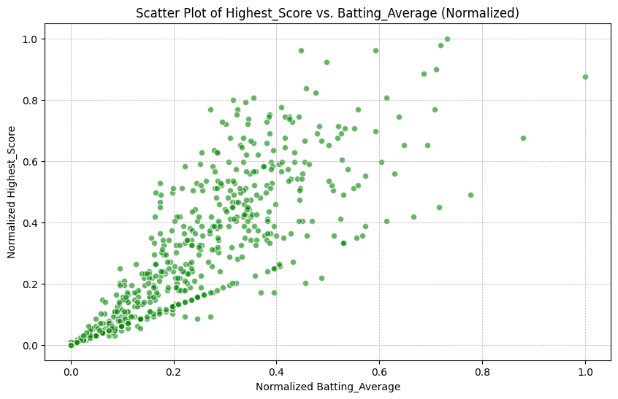
Data Visualization #1
-

Slide 7
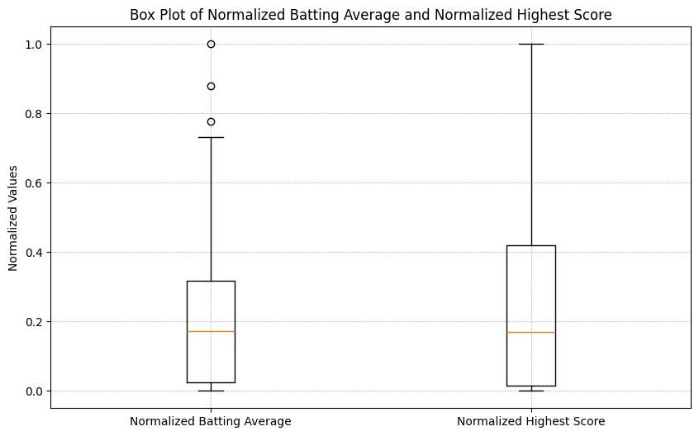
Data Visualization #2
-

Slide 8
Write a paragraph about what your 2 visualizations mean in context
VISUALIZATION-1
The scatter plot visualizes the relationship between normalized batting averages and normalized highest scores in a dataset. Each point represents a player's performance, with the x-axis showing their normalized batting average and the y-axis indicating their normalized highest score. The plot suggests a positive correlation between batting average and highest score, implying that players with higher batting averages tend to achieve higher scores.
VISUALIZATION-2
The box plot displays the distribution of normalized batting averages and normalized highest scores. Each box represents the interquartile range (IQR) of the data, with the median indicated by a line inside the box. The whiskers extend to the minimum and maximum values, while any outliers beyond them are represented as individual points. This visualization helps to compare the spread and central tendency of the two normalized variables

Slide 9
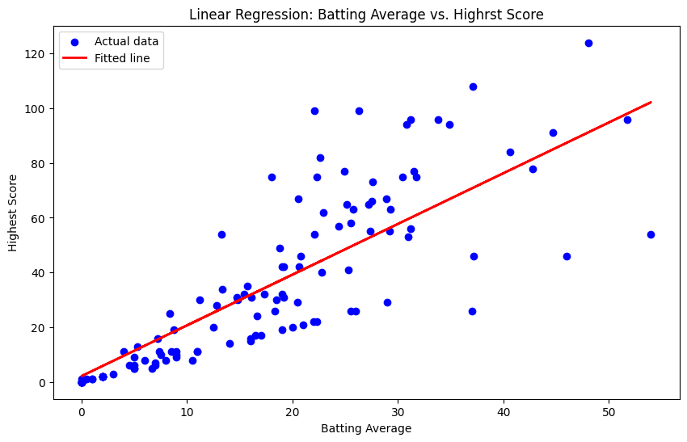
RESULT

Slide 10
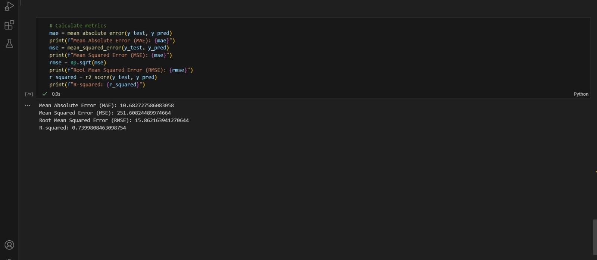

Slide 11
Machine Learning
The Mean Absolute Error (MAE) provides the average magnitude of errors between predicted and actual values, giving a sense of the model's overall accuracy.
The Mean Squared Error (MSE) squares these errors, amplifying the impact of larger deviations, making it sensitive to outliers.
The Root Mean Squared Error (RMSE) is interpretable in the same units as the target variable and is useful for understanding the typical error magnitude. R-squared measures the proportion of variance in the dependent variable that is predictable from the independent variables, with higher values indicating better fit.

Slide 12
Model Evaluation
Cross-Validation: Utilize techniques like k-fold cross-validation to assess model performance on multiple subsets of the data. This helps in obtaining a more reliable estimate of model performance and reduces the risk of overfitting.
Use Multiple Metrics: Instead of relying solely on one metric, consider using a combination of metrics like accuracy, precision, recall, F1-score, ROC-AUC, etc., depending on the problem domain. This provides a more comprehensive understanding of model behavior.
Domain Knowledge: Incorporate domain expertise to choose relevant evaluation metrics and interpret the results correctly. This ensures that the evaluation aligns with the specific goals and requirements of the problem being solved.
Feature Engineering: Improve model performance by refining features, creating new ones, or selecting the most informative ones. This can enhance the model's ability to capture underlying patterns in the data.
Ensemble Methods: Combine predictions from multiple models to improve overall performance. Techniques like bagging, boosting, and stacking can help in reducing variance, bias, and generalization errors.
Hyperparameter Tuning: Optimize model hyperparameters using techniques like grid search, random search, or Bayesian optimization. Fine-tuning hyperparameters can significantly enhance model performance.
Model Selection: Experiment with different algorithms and architectures to identify the most suitable model for the given task. Consider factors like computational efficiency, interpretability, and scalability alongside predictive performance.
Error Analysis: Conduct thorough error analysis to understand the types of mistakes the model makes and identify patterns or trends in misclassifications. This insight can guide further model refinement and data preprocessing.
Validation Set: Reserve a separate validation set or use techniques like nested cross-validation to assess model performance on unseen data. This helps in detecting overfitting and ensures that the model generalizes well to new instances.

Slide 13
THANK YOU

